Slide 1
Lecture 34

Slide 2
End

Slide 3
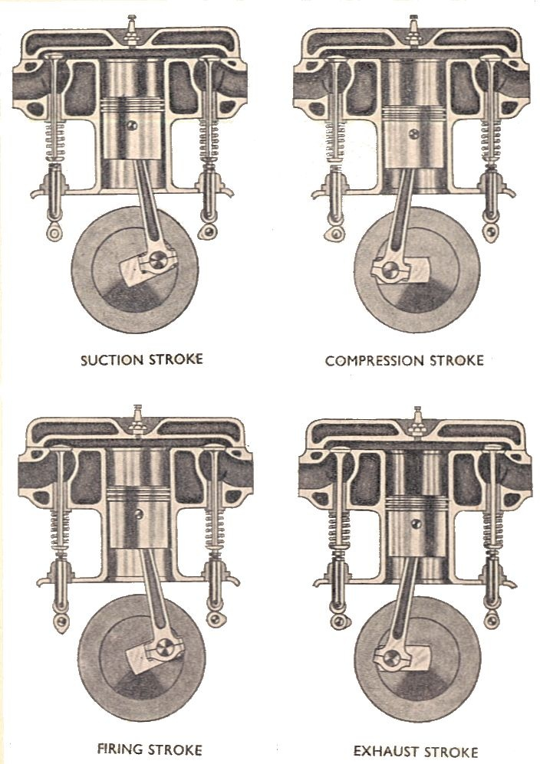
Manual of Driving and Maintenance for Mechanical Vehicles (Wheeled)

Slide 4
C
B
Pressure (Pa)
D
I
A
Volume (m³)

Slide 5
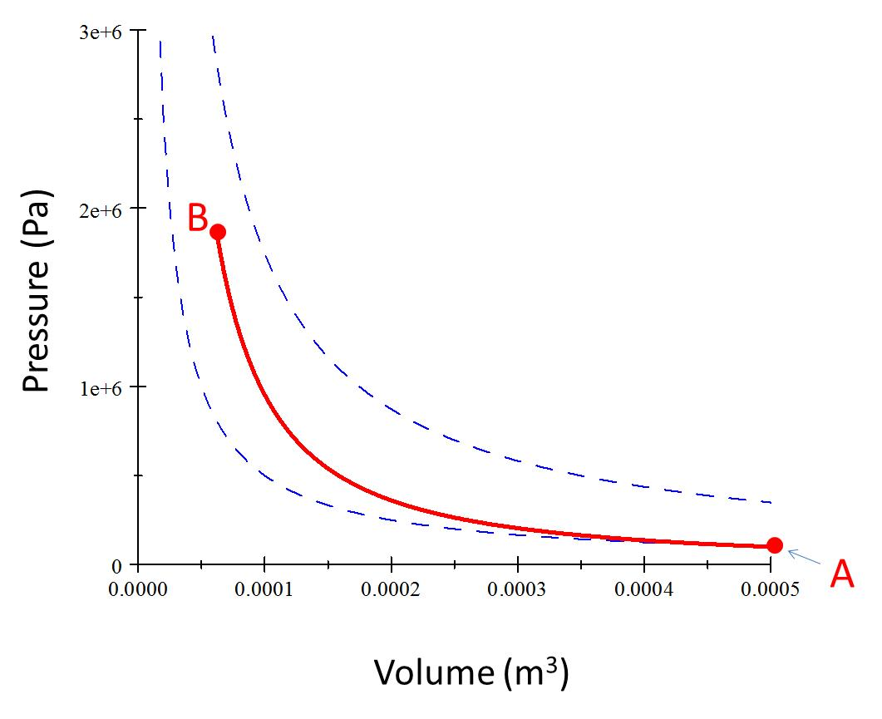
Process AB
Piston raises

Slide 6
C
B
Pressure (Pa)
Volume (m³)

Slide 7
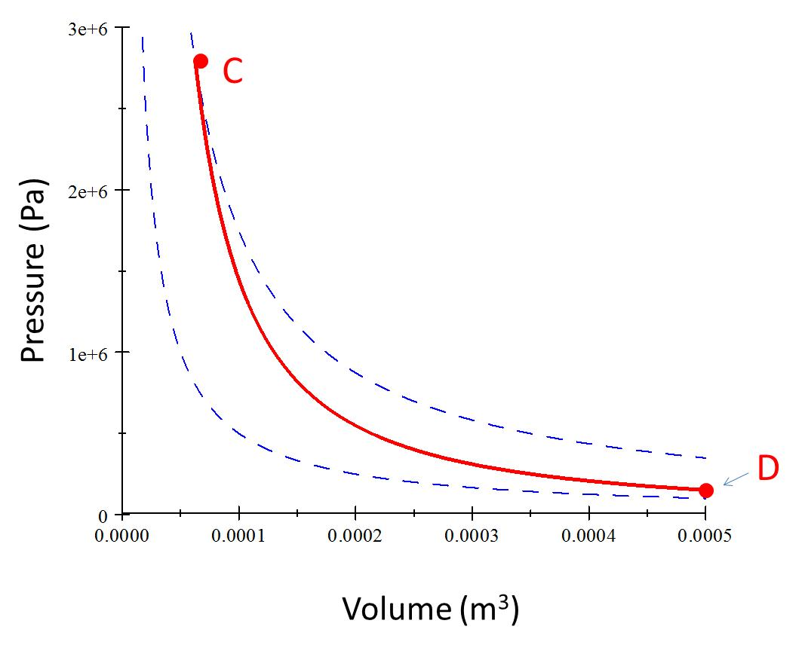
Process CD (Power Stroke)
Piston Lowers

Slide 8
Pressure (Pa)
D
A
Volume (m³)

Slide 9
Process AI
Exhaust valve opens
Piston rises

Slide 10
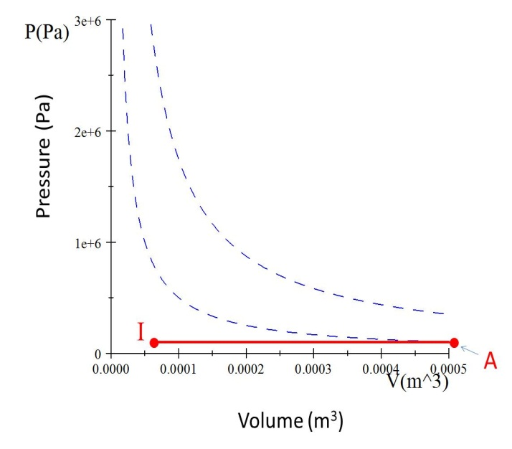
Process IA
Intake valve opens
Piston Lowers

Slide 11
C
Q_{h}
B
Pressure (Pa)
Work Required
Useful Work Out
D
I
Q_{c}
A
Volume (m³)

Slide 12
B
Pressure (Pa)
A
Volume (m³)

Slide 13
C
Pressure (Pa)
D
Volume (m³)

Slide 14
Pressure (Pa)
I
A
Volume (m³)

